Slide 1


California
Department of Insurance
Durriya Syed
Northern CA Outreach Analyst
Community Relations & Outreach Branch

Slide 2
Role of Insurance Commissioner
Protect Consumers
Maintain Insurer Solvency
Perform market conduct reviews
Set standards for agents and broker licensing
Resolve consumer complaints
Investigate and prosecute insurance fraud
Enforce the insurance laws of California

Slide 3
The Insurance Market
Inflation is creating unprecedented financial stress to insurance markets.
Increased costs of rebuilding, supplies, materials, labor shortages, among other costs, are affecting insurance markets.
As risk grows, insurance markets are contracting to protect solvency, meet financial obligations and regulatory mandates.
Natural disasters & global inflation have increased insured losses and costs worldwide like never before.

Slide 4
Safer From Wildfires
Protect your home or business
+
Protect the immediate surroundings
+
Protect the whole community

Slide 5
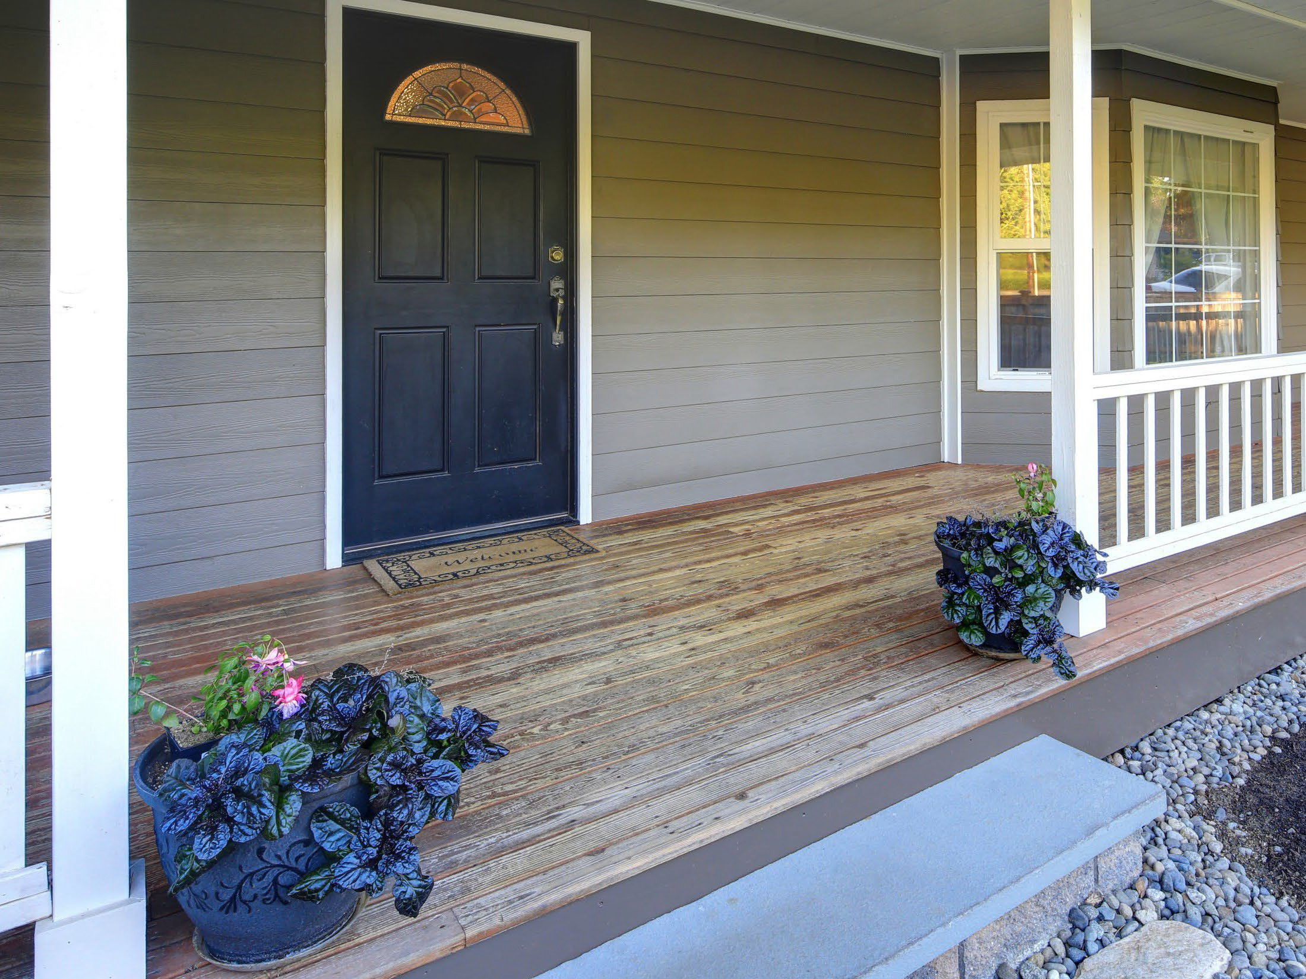
Protect your
home or business
Class A fire-rated roof
5-foot ember-resistant zone around the structure
Noncombustible 6 inches at the bottom
Ember- and fire-resistant vents
Double pane windows or added shutters
Enclosed eaves
of walls

Slide 6

Protect the
immediate surroundings
Cleared vegetation and debris from under
Move sheds and outbuildings at least 30 feet away
Trim trees and remove brush in compliance with state and local defensible space laws
decks

Slide 7
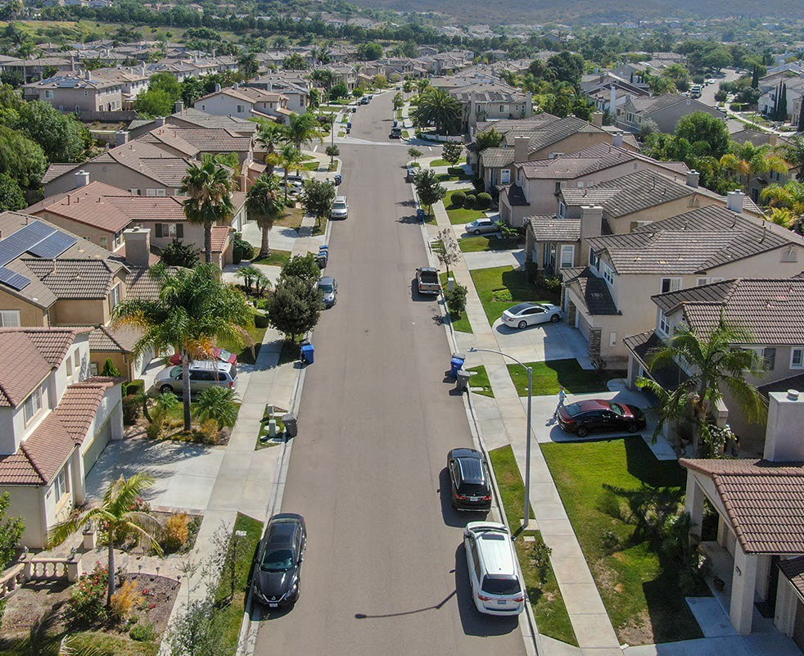
Protect the
whole community
•
•
Neighborhoods can form a Firewise USA community
Cities, counties, and local districts can become certified as a Fire Risk Reduction Community

Slide 8
CA FAIR Plan & Wildfire Risk Score
The CA FAIR Plan offers insurance discounts
The CA FAIR Plan is offering 20 million dollar coverage per location for commercial policies, including HOAs
Wildfire Risk Score - regulation allows consumers to request and appeal their property risk score

Slide 9
California Sustainable Insurance Strategy
Insurer commitments to write more policies in wildfire distressed areas and reduce FAIR Plan policies in order to achieve greater availability
New climate risk management tools – catastrophe modeling and reinsurance costs
Strengthen and Modernize the FAIR Plan - expanding commercial coverage limits to $20 million per structure closes coverage gaps for many
Improve Department’s rate application approval process with faster rate filing approval times to create more certainty in insurance market

Slide 10
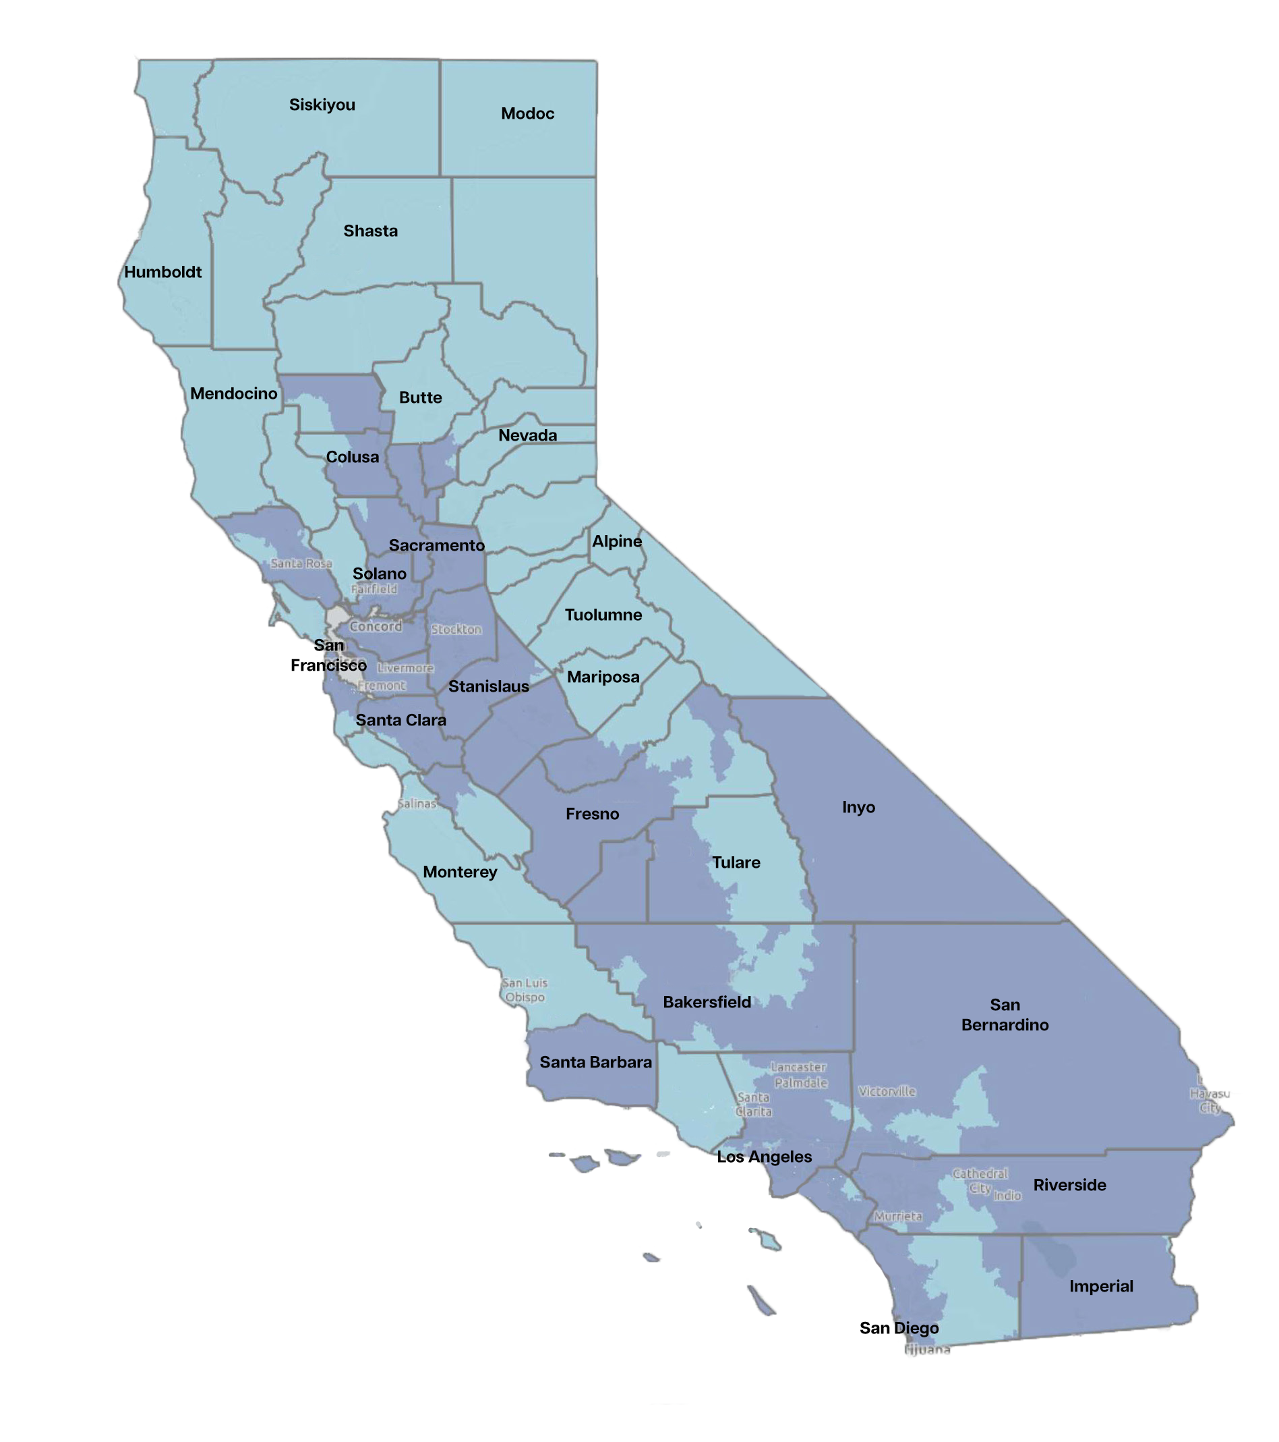
Concentration of FAIR Plan policies and wildfire risk
Areas of higher concentration of FAIR Plan policies and wildfire risk
Areas of lower concentration of FAIR Plan policies and wildfire risk

Slide 11
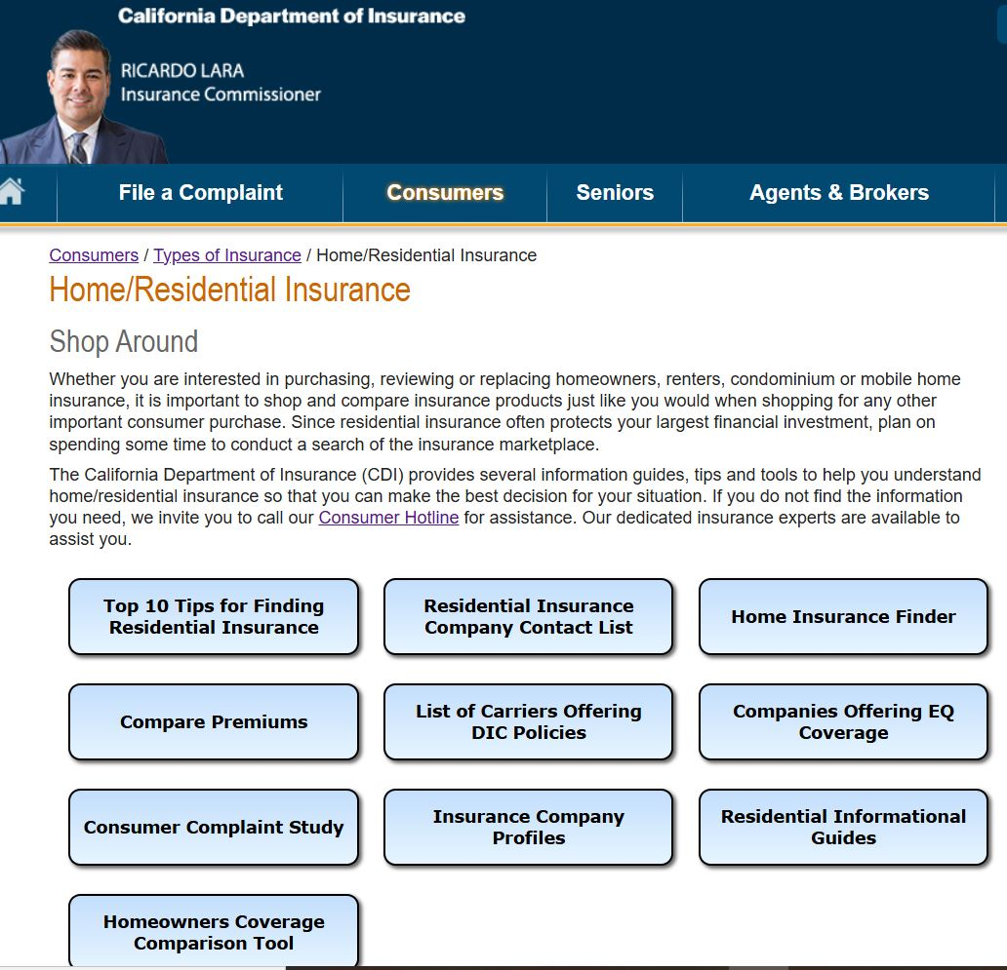
Online Tools Available at
insurance.ca.gov
What’s Next for SIS?
Catastrophe models are now being reviewed
Insurance companies will need to submit complete rate applications
Insurance companies are expected to have new policies available once the rate filings incorporating reinsurance and cat-modeling are approved
Top Ten Tips
Insurance Finder Tool

Slide 12
Online Tools Available at
insurance.ca.gov
Top Ten Tips
Insurance Finder Tool

Slide 13
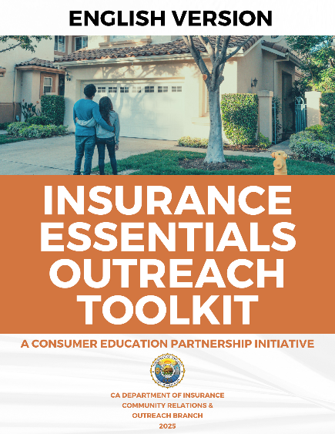

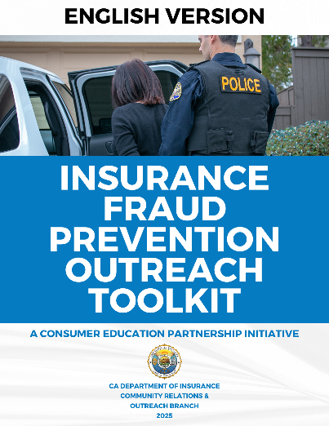
How to Partner with Us
Sign up for our Community Outreach
and Education Partnership Initiative by clicking
QR code:
Get access to:
Comprehensive consumer education materials
Powerful social media tools

Slide 14
Getting Help
Visit website at www.insurance.ca.gov
File a Complaint/Request for Assistance
Consumer Hotline: 1-800-927-4357 or Consumer Live Chat via website
Sign up to receive Consumer Alerts directly to your inbox (click on orange banner on home page)

